Slide 1
FINAL exam REVIEW
APS106

Slide 2
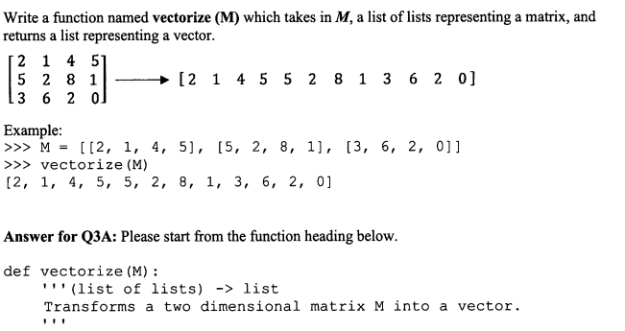
Question 1 · FINAL JEOPARDY

Slide 3
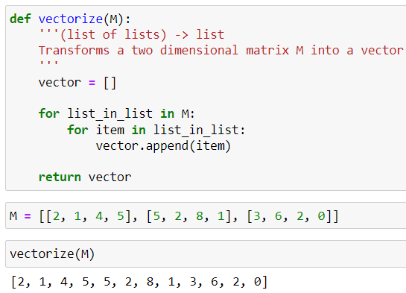
Our solution:
Question 1 · FINAL JEOPARDY

Slide 4
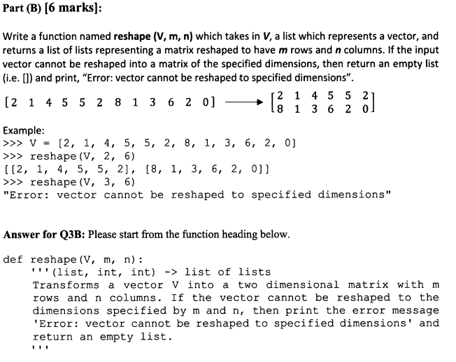
LONG ANSWER Question 1 · FINAL JEOPARDY

Slide 5
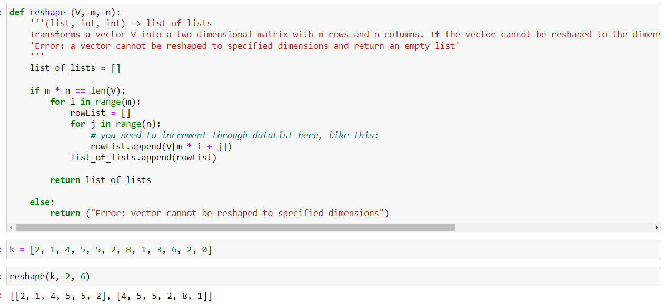
Our solution:
LONG ANSWER Question 1 · FINAL JEOPARDY

Slide 6
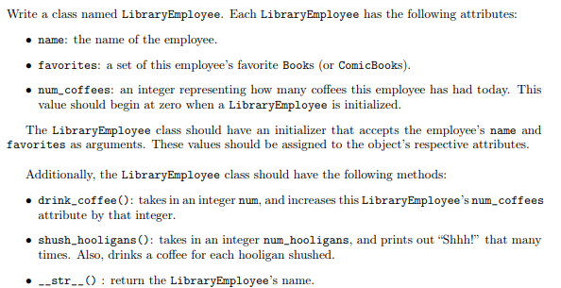
LONG ANSWER Question 2· FINAL JEOPARDY
Copyright: Stanford

Slide 7
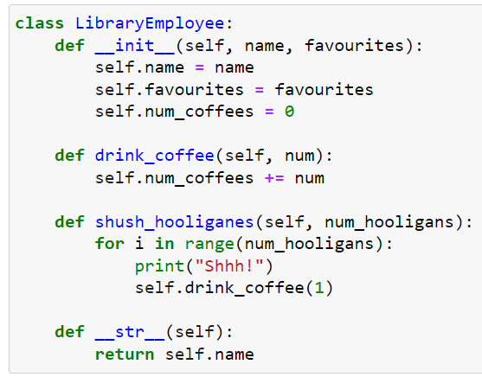
LONG ANSWER Question 2· FINAL JEOPARDY

Slide 8
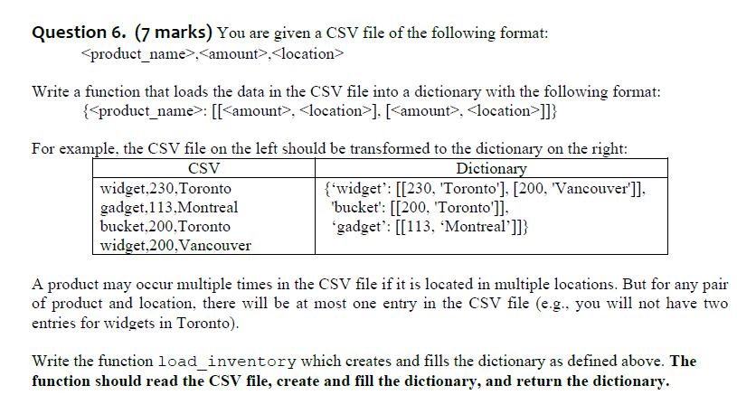
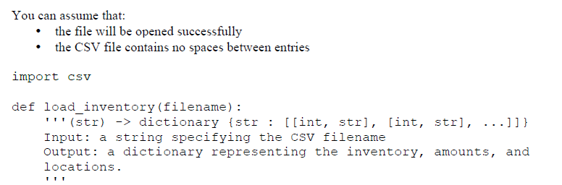
LONG ANSWER Question 3· FINAL JEOPARDY

Slide 9
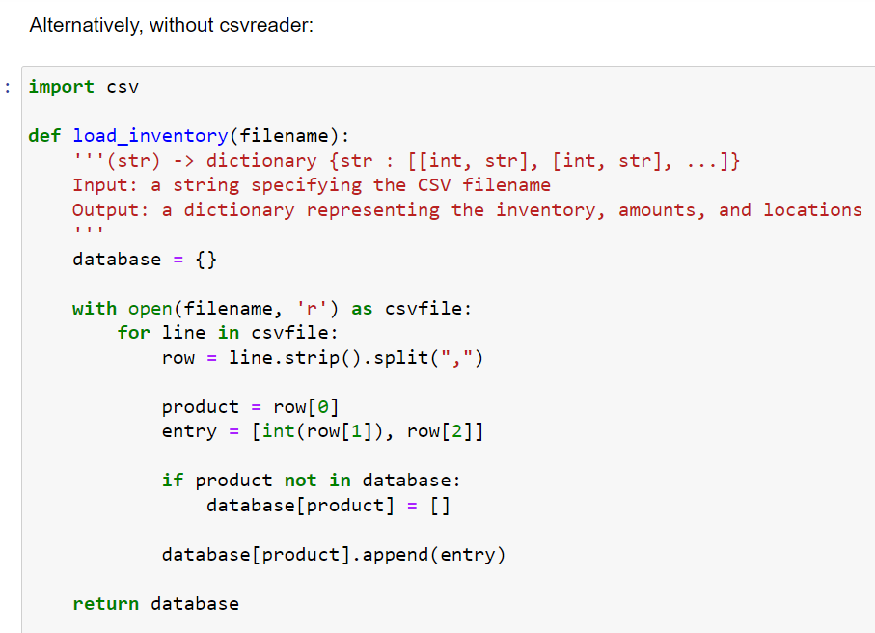
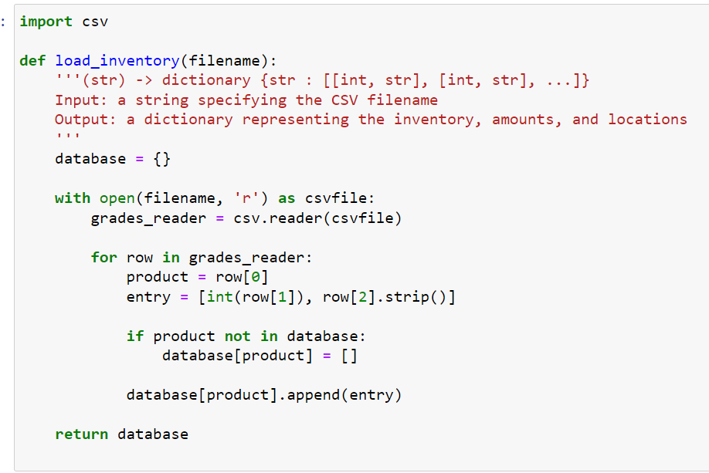
LONG ANSWER Question 3· FINAL JEOPARDY

Slide 10
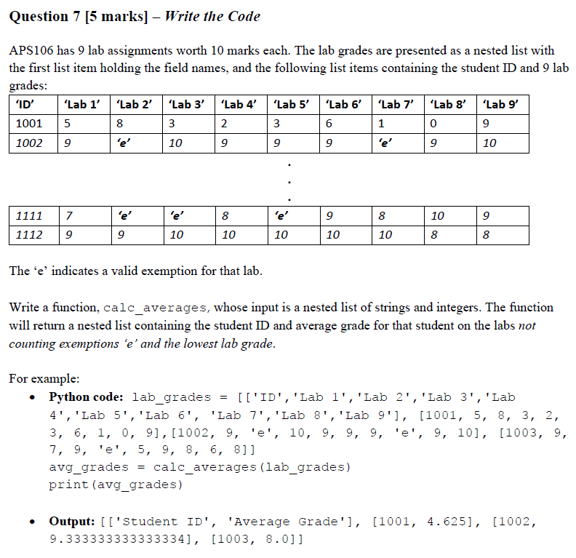
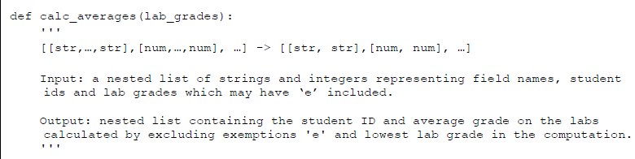
LONG ANSWER Question 4· FINAL JEOPARDY

Slide 11
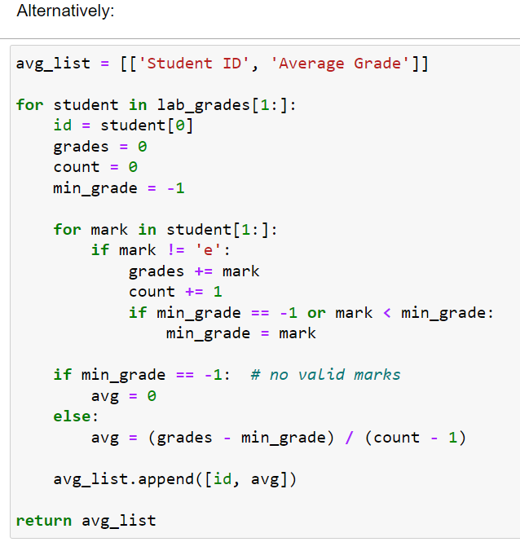
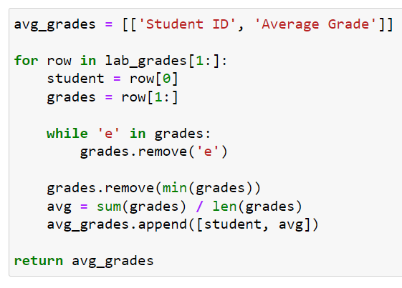
LONG ANSWER Question 4· FINAL JEOPARDY

